Slide 1


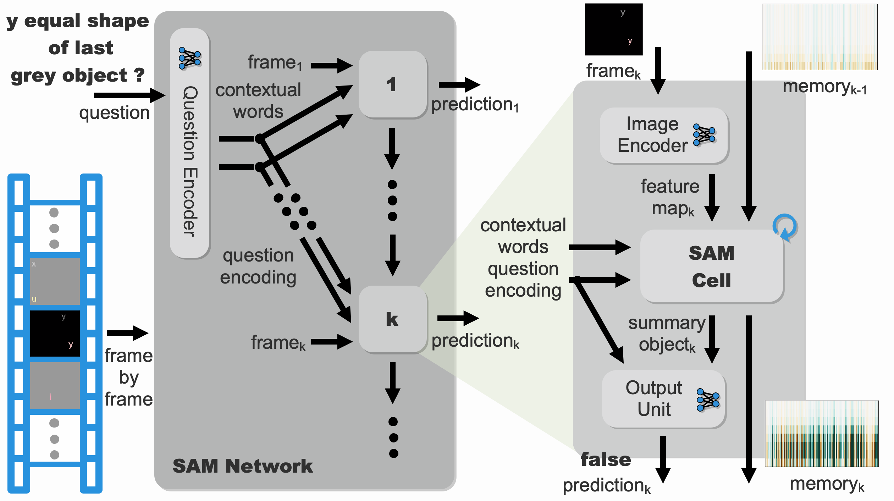
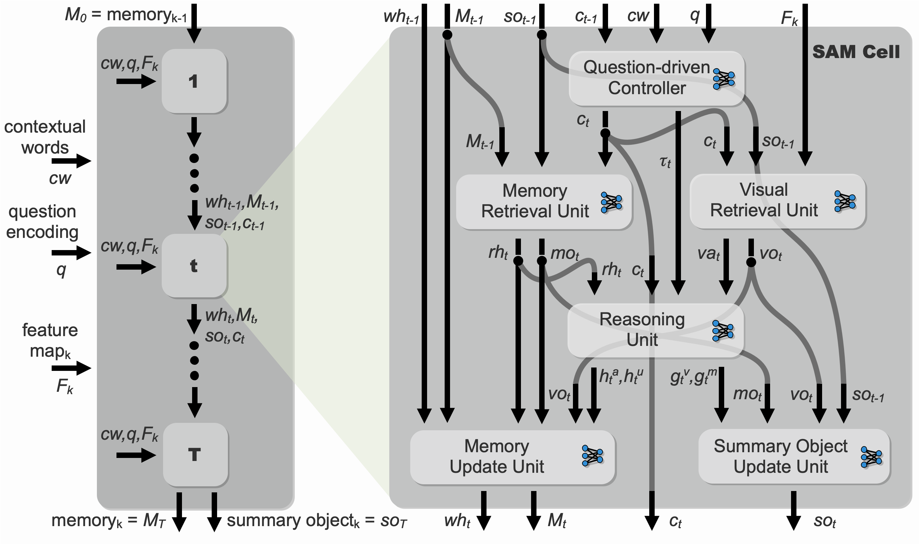
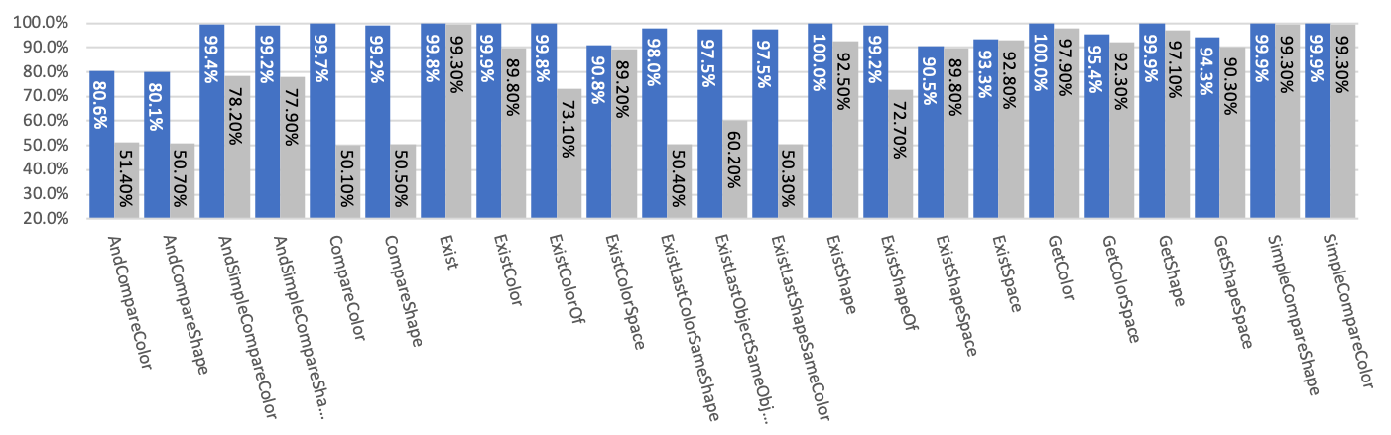
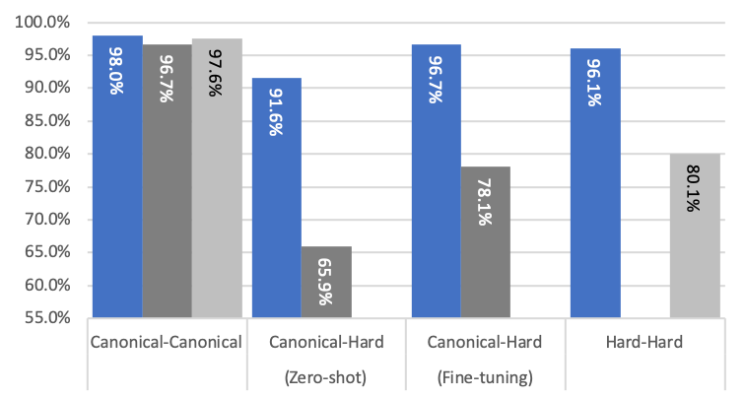
Visually Grounded Video Reasoning in Selective Attention Memory
T.S. Jayram, Vincent Albouy, Tomasz Kornuta, Emre Sevgen, Ahmet S. Ozcan
IBM Research AI, Almaden Research Center, San Jose, USA
Introduction
COG Dataset
Video reasoning involves temporal concepts & object relations
New model: Selective Attention Memory Network (SAMNet)
End-to-end differentiable model with external memory
Dynamically processes video input frame-by-frame
Multi-step reasoning over each frame
Stores salient concepts in memory
SAMNet outperforms state-of-the-art baseline model [1]
Particularly, on the “Hard” variant of the COG dataset [1]
Generalizes to longer sequences and more complex scenes
Performs grounding of time-related words with meaning
Learns complex, multi-step reasoning that involves grounding of text with visual representations of objects and relations
Selectively controls the flow of information to and from memory
Uses temporal context to store only relevant visual information
A dataset for visual reasoning with a working memory
Sample question/answer & sequence from the COG dataset [1]
Tasks test relational reasoning and memory capacity
Can involve objects in current as well as previous frames
Dataset setting | # of frames | Max memory duration | # of distractors | Size of training set | Size of validation /test set
Canonical | 4 | 3 | 1 | 10 million | 0.5 million
Hard | 8 | 7 | 10 | 10 million | 0.5 million
[1] Yang et al. ECCV 2018, https://arxiv.org/abs/1803.06092
SAMNet Model
Overall SAMNet architecture and dataflow
Detailed architecture of the SAM Cell
Results
Test accuracy per task on the Hard variant of COG : SAMNet vs. Baseline Model [1]
Generalization Across Datasets
SAMNet
Baseline
SAMNet
Baseline
(Paper)
Baseline
(Code)
X-axis: A (trained) – B (tested)
Fine-tuning: Train on A, retrain on B, test on B
Zero-shot: No retraining
Significant improvements on tasks where two or more objects need to be kept in memory for reasoning

